Slide 1
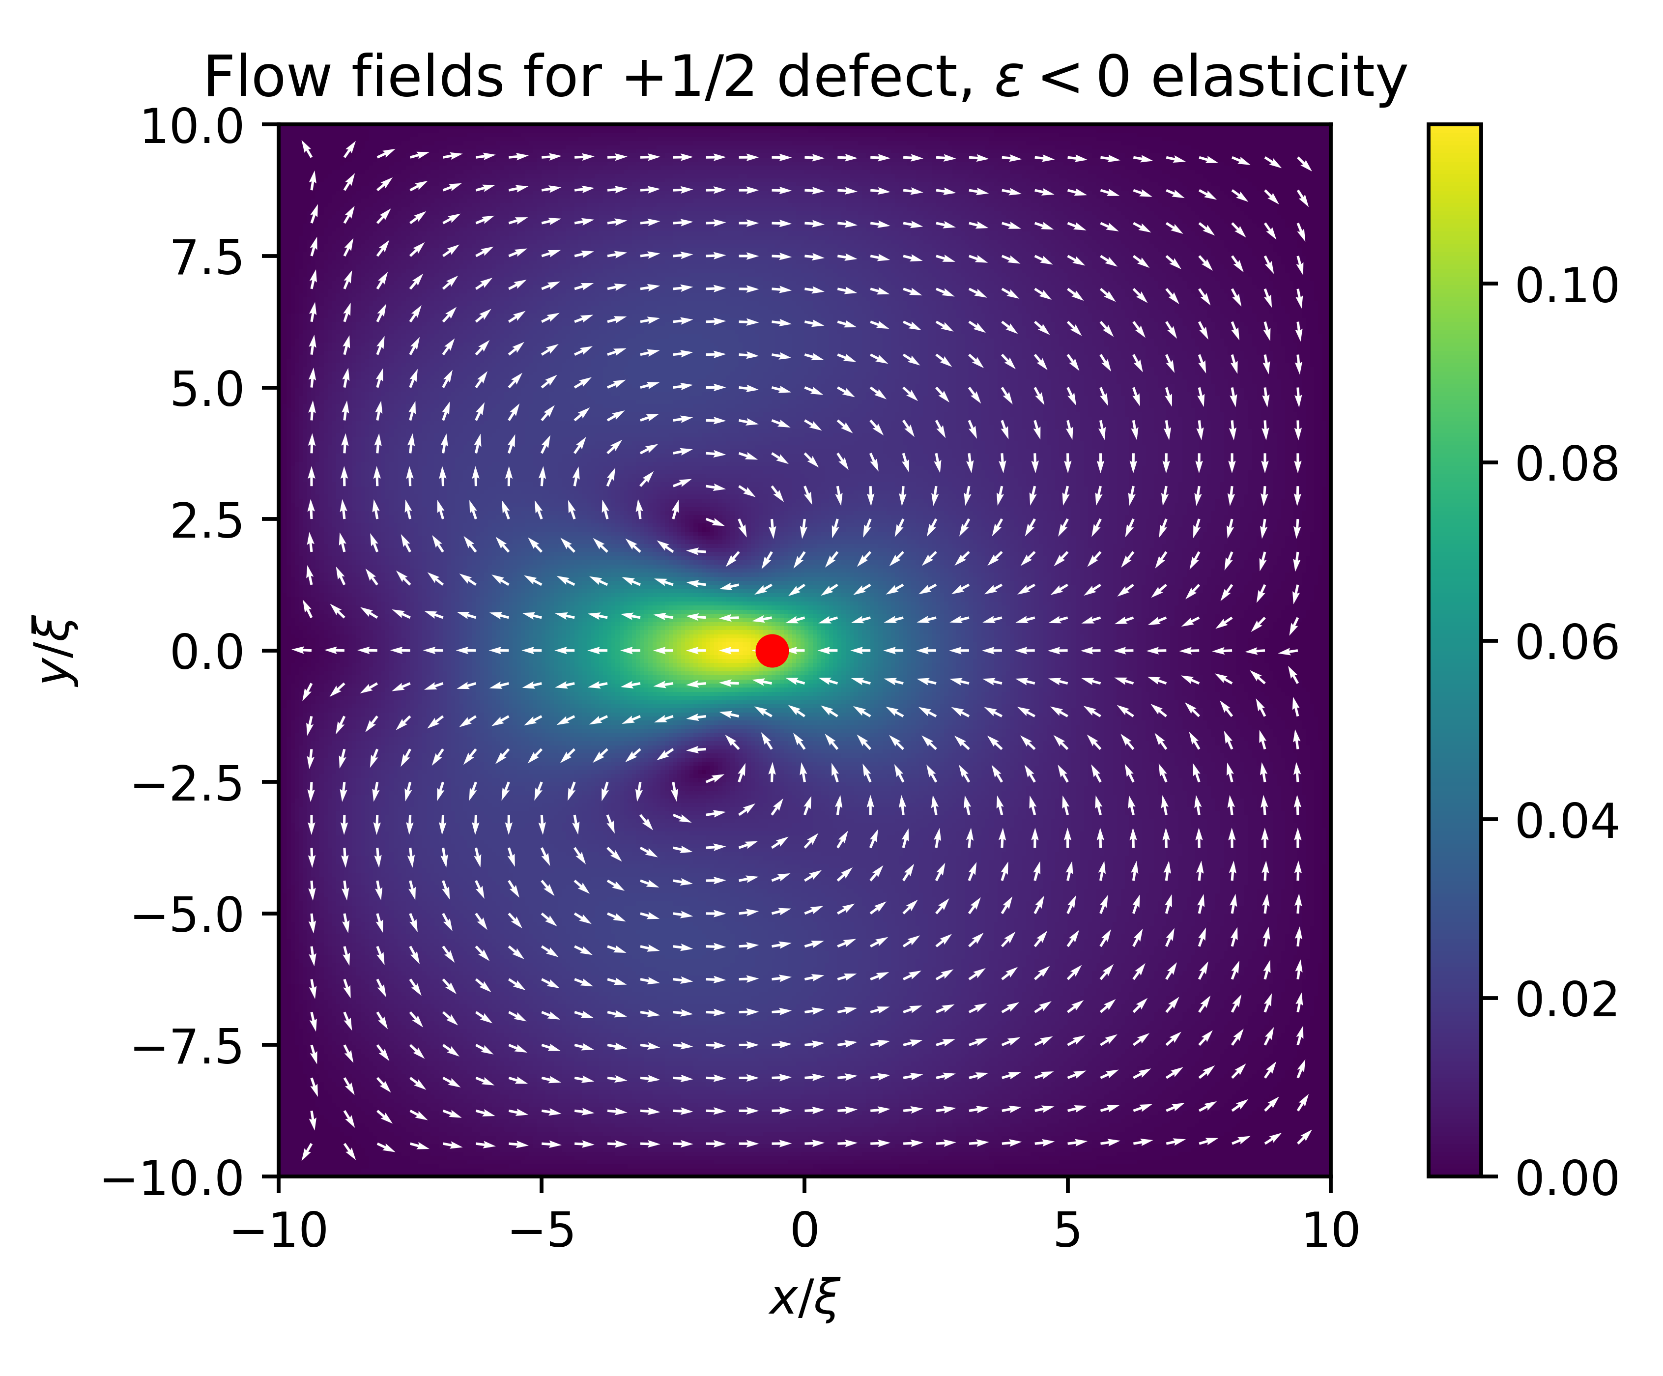
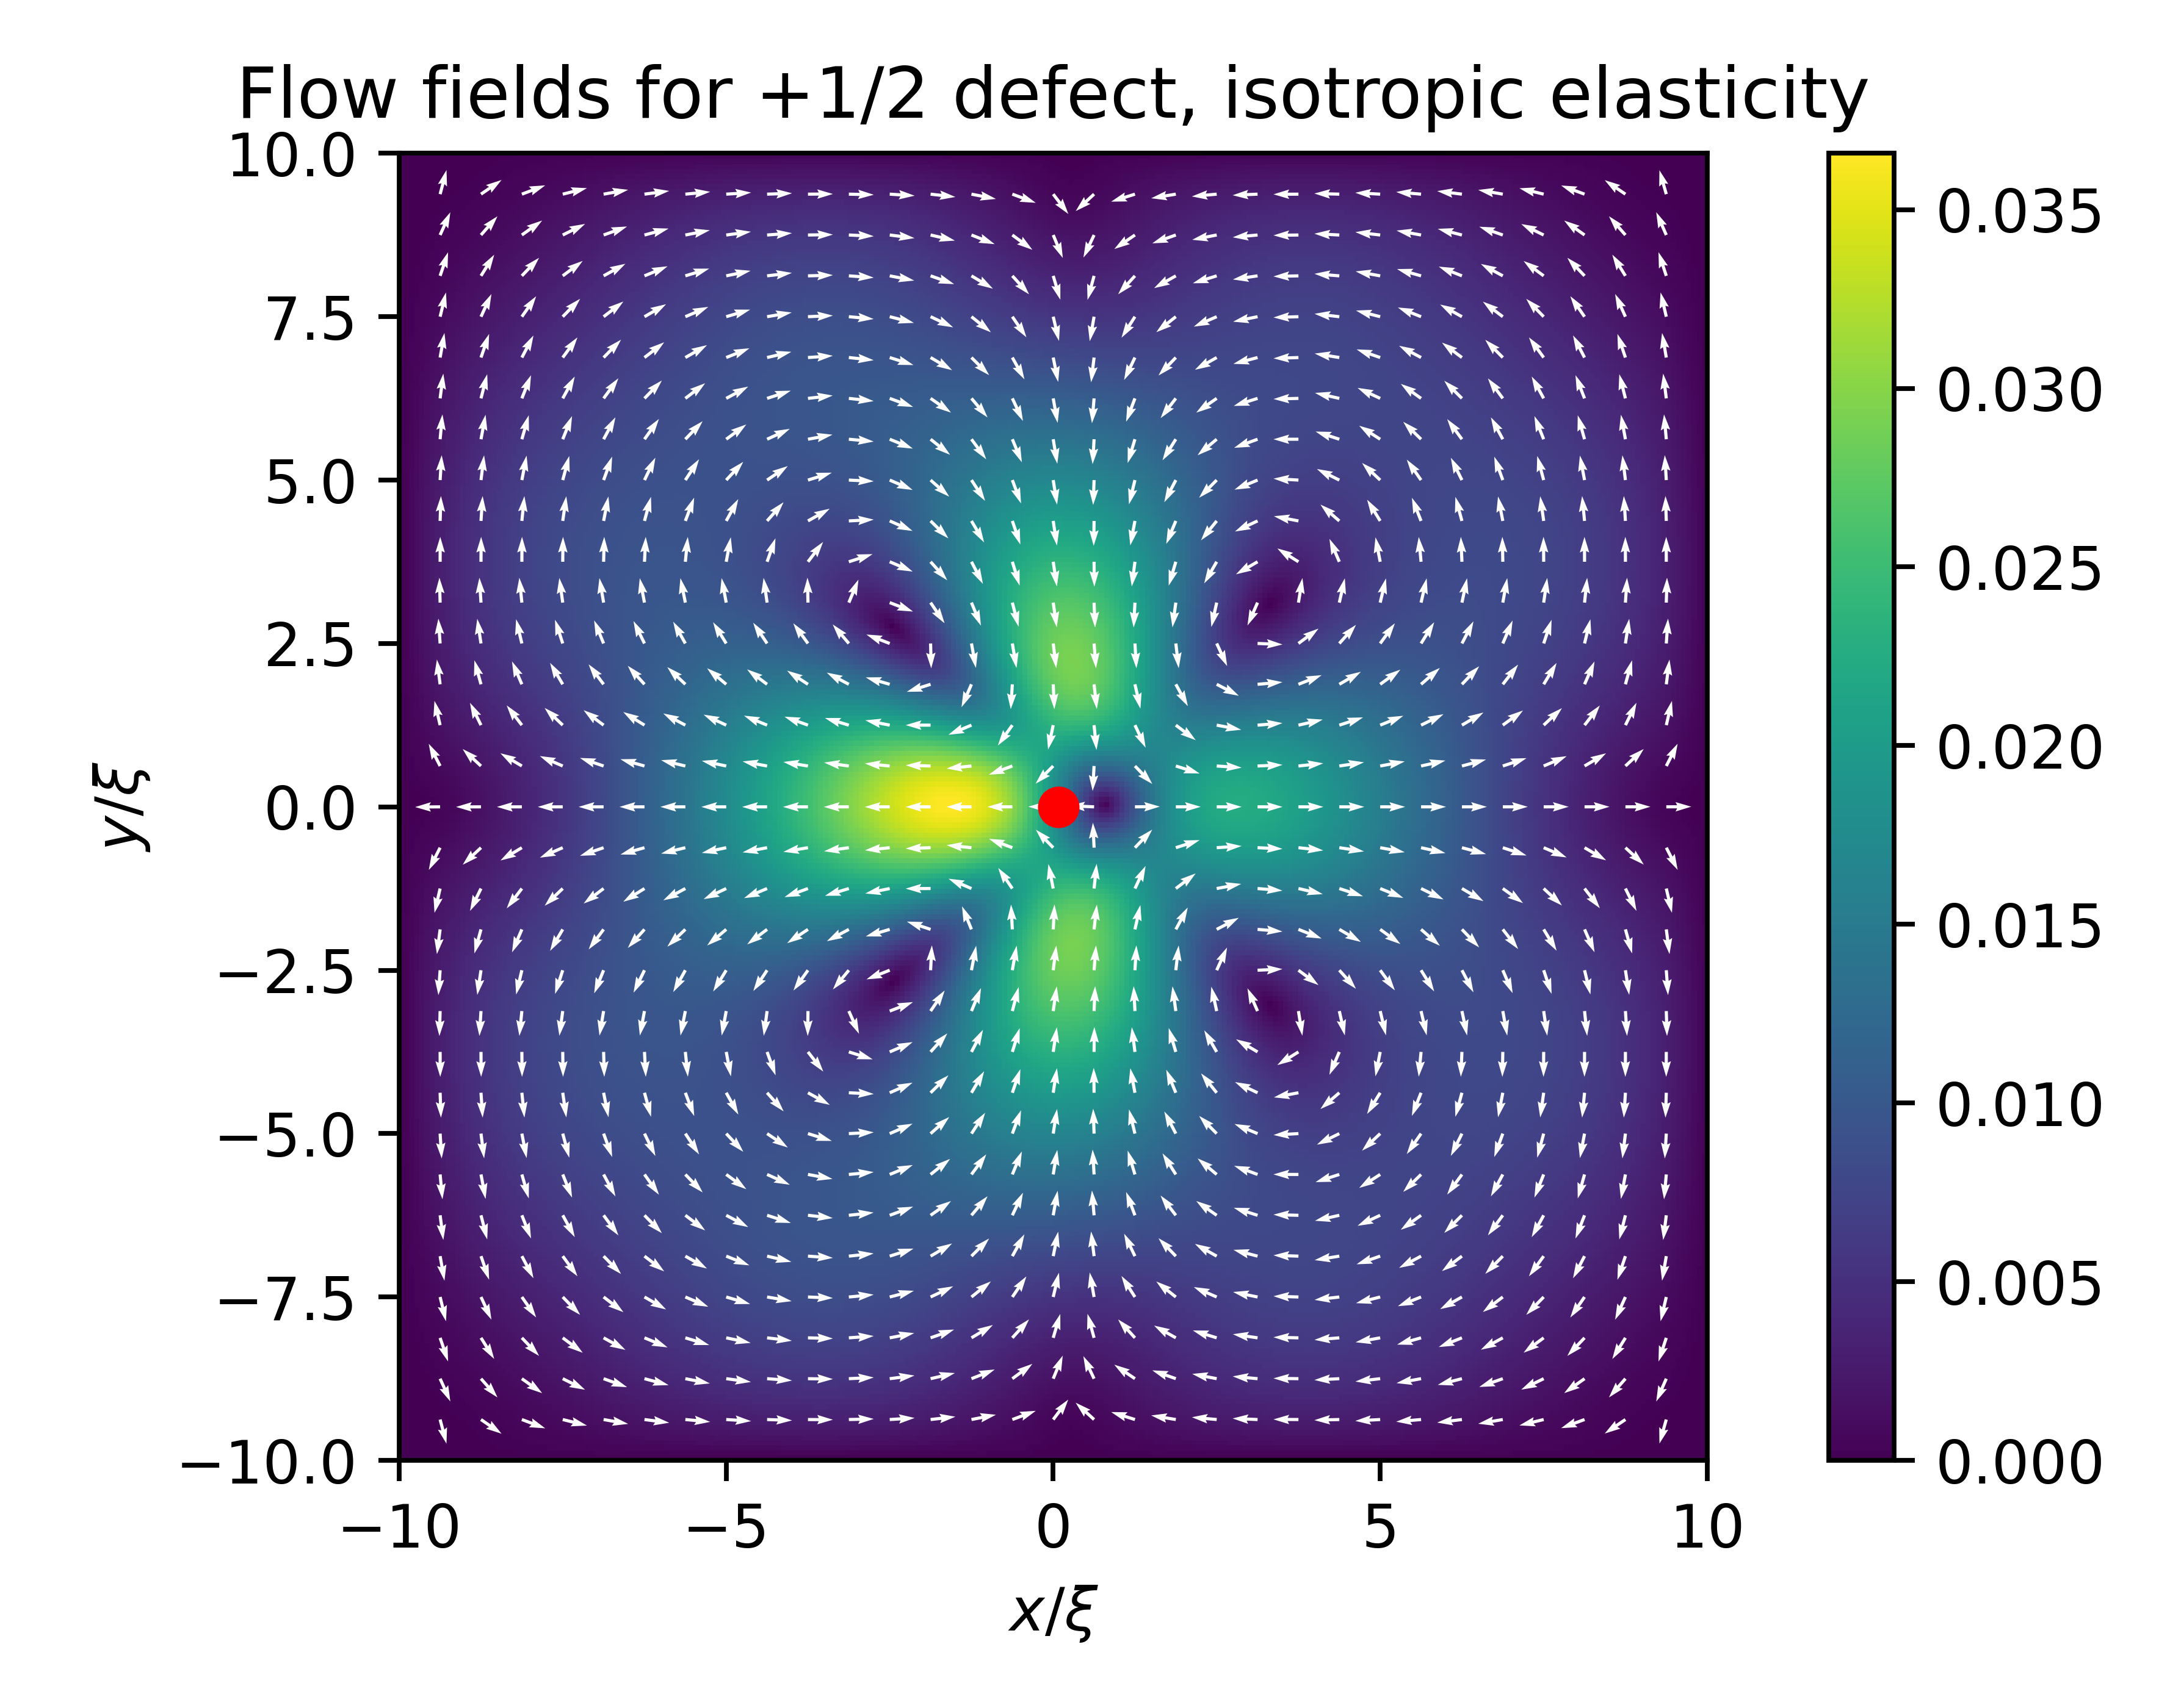
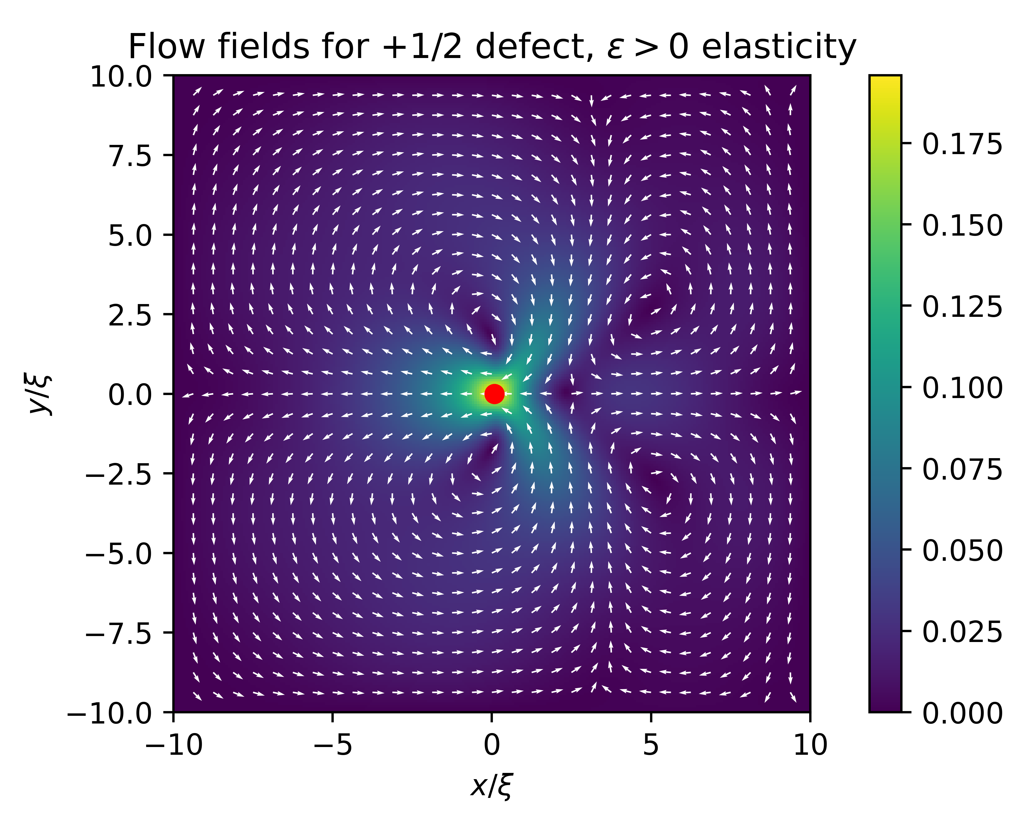
Had confusion over asymmetry

Slide 2
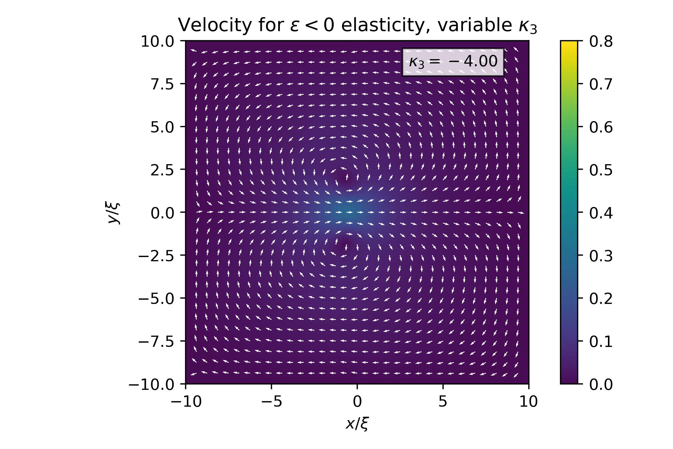

Video for $κ_{3}=−1$ equilibrium config

Slide 3
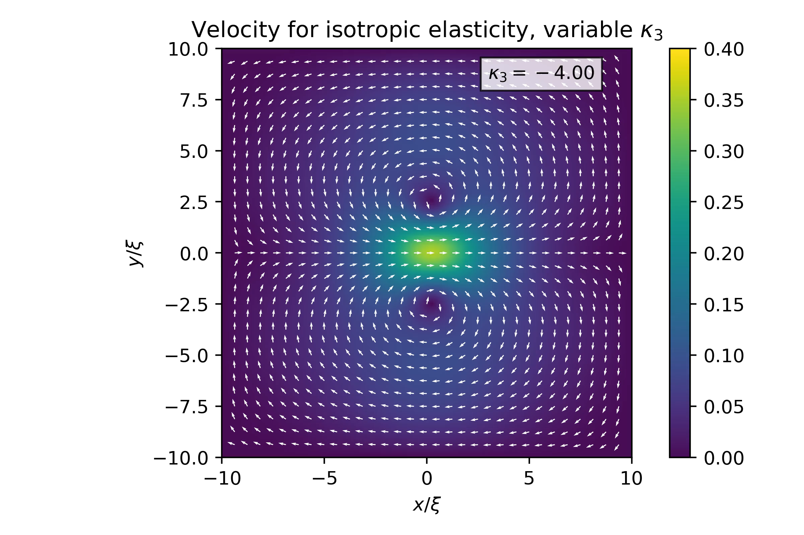

Video for $κ_{3}=0$ equilibrium config

Slide 4
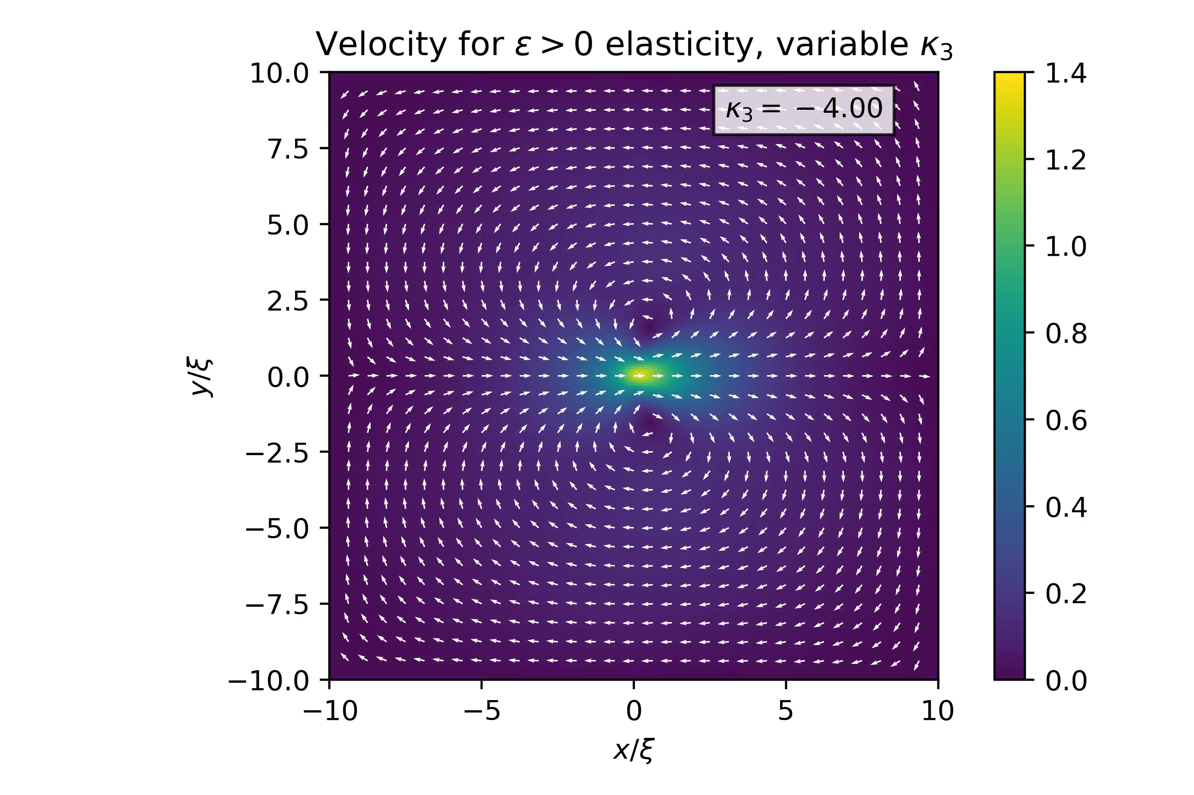

Video for $κ_{3}=4$ equilibrium config

